Slide 1
CASE STUDY WEAR MANAGEMENT
SOLUTION

Slide 2
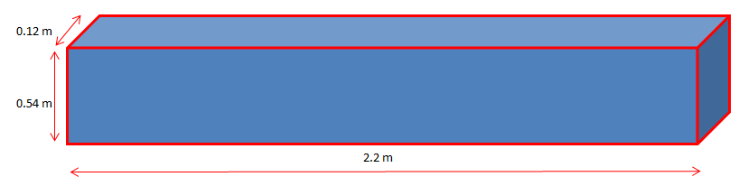

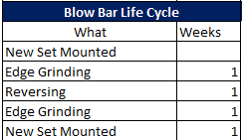
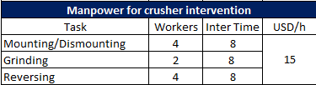

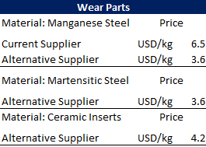
Case Study PART B - Wear Management

Slide 3
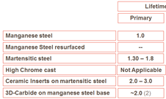
Tasks for wear management
What is the actual cost of crushing wear parts (parts + manpower)?
What will be the cost if a MnSt Alternative Supplier is used?
You want to test alternative blow bar alloy, choose one (Martensitic, Ceramic Inserts) and calculate the crushing wear part cost.

Slide 4
CASE STUDY SOLUTION
What is the actual cost of wear (Parts + Manpower)?
First Number of t per blow bars set
6 x 1.100 kg = 6.600 kg x 0.25 (%Wear) = 1.650 kg
Net wear rate = 8.6 g/t
1.650 kg x 1000 g/kg /8.6 g/t = 191.860 t
Now, how many sets per year
2.400.000 t/a / 191.860 t/set = 12.5 Set/a
Cost of 1 set of bars = 6.600 kg x 6.5 USD/kg = 42.900 USD
Total annual cost = 12.5 x 42.900 USD = 536.250 USD
Second the cost of manpower per blow bar set
Mounting & Dismounting
4 x 8 h x 15 USD/h = 480 USD
Grinding & Reversing
( 2 x 8 x 2h + 4 x 8 h ) x 15 USD/h = 960 USD
Total manpower cost per set of blow bars
1.440 USD
Along the year
1.440 x 12.5 = 18.0000 USD
The actual cost, per year, of wear is then → 536.250 USD + 18.000 USD = 554.250 USD
The crusher annual production is 2.400.000 t → 0.23 USD/t

Slide 5
CASE STUDY SOLUTION
What is MnSt alternative supplier cost of wear (Parts + Manpower)?
First Number of t per blow bars set
6 x 1.100 kg = 6.600 kg x 0.25 (%Wear) = 1.650 kg
Net wear rate = 8.6 g/t
1.650 kg x 1000 g/kg /8.6 g/t = 191.860 t
Now, how many sets per year
2.400.000 t/a / 191.860 t/set = 12.5 Set/a
Cost of 1 set of bars = 6.600 kg x 3.6 USD/kg = 23.760 USD
Total annual cost = 12.5 x 23.760 USD = 297.000 USD
Second the cost of manpower per blow bar set
Mounting & Dismounting
4 x 8 h x 15 USD/h = 480 USD
Grinding & Reversing
( 2 x 8 x 2 h + 4 x 8 h ) x 15 USD/h = 960 USD
Total manpower cost per set of blow bars
1.440 USD
Along the year
1.440 x 12.5 = 18.000 USD
The actual cost, per year, of wear is then → 297.000 USD + 18.000 USD = 315.000 USD
The crusher annual production is 2.400.000 t → 0.13 USD/t

Slide 6
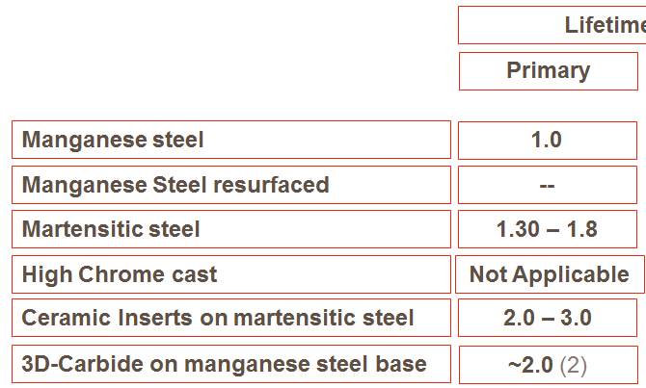
CASE STUDY SOLUTION
What is MtSt alternative supplier cost of wear (Parts + Manpower)?
First Number of t per blow bars set
6 x 1.100 kg = 6.600 kg x 0.25 (%Wear) = 1.650 kg
Net wear rate = 8.6 g/t
Corrected net wear rate by lifetime factor of 1.5
Net Wear Rate2 = 8.6 g/t / 1.5 = 5.7 g/t
1.650 kg x 1000 g/kg /5.7 g/t = 289.473 t
Now, how many sets per year
2.400.000 t/a / 289.473 t/set = 8.3 Set/a
Cost of 1 set of bars = 6.600 kg x 3.6 USD/kg = 23.760 USD
Total annual cost = 8.3 x 23.760USD = 197.208 USD
Second the cost of manpower per blow bar set
Mounting & Dismounting
4 x 8 h x 15 USD/h = 480 USD
Grinding & Reversing
( 2 x 2 x 8 h + 4 x 8 h ) x 15 USD/h = 960 USD
Total manpower cost per set of blow bars
1.440 USD
Along the year
1.440 x 8.3 = 11.952 USD
The actual cost, per year, of wear is then → 197.208 USD + 11.952 USD = 209.160 USD
The crusher annual production is 2.400.000 t → 0.09 USD/t

Slide 7
CASE STUDY SOLUTION
What is MtSt alternative supplier cost of wear (Parts + Manpower)?
First Number of t per blow bars set
6 x 1.100 kg = 6.600 kg x 0.25 (%Wear) = 1.650 kg
Net wear rate = 8.6 g/t
Corrected net wear rate by lifetime factor of 2.5
Net Wear Rate2 = 8.6 g/t / 2.5 = 3.4 g/t
1.650 kg x 1000 g/kg /3.4 g/t = 485.295 t
Now, how many sets per year
2.400.000 t/a / 485.295 t/set = 4.9 Set/a
Cost of 1 set of bars = 6.600 kg x 4.2 USD/kg = 27.720 USD
Total annual cost = 4.9 x 27.720 USD = 135.828 USD
Second the cost of manpower per blow bar set
Mounting & Dismounting
4 x 8 h x 15 USD/h = 480 USD
Grinding & Reversing
( 2 x 2 x 8 h + 4 x 8 h ) x 15 USD/h = 960 USD
Total manpower cost per set of blow bars
1.440 USD
Along the year
1.440 x 4.9 = 7.056 USD
The actual cost, per year, of wear is then → 135.828 USD + 7.056 USD = 142.884 USD
The crusher annual production is 2.400.000 t → 0.06 USD/t

